Slide 1
15.S60 visualization in R
Software Tools for Operations Research
January 14, 2014

Slide 2
why visualization?
"the picture-examining eye is the best finder we have of the wholly unanticipated”
-John Tukey
see relationships, structures, distributions, outliers, patterns, behaviors, dependencies, outcomes

Slide 3
high level outline
understand your data + intro to ggplot
about 90 minutes
understand your model
about 40 minutes
communicate your findings + best practices
About 20 minutes

Slide 4
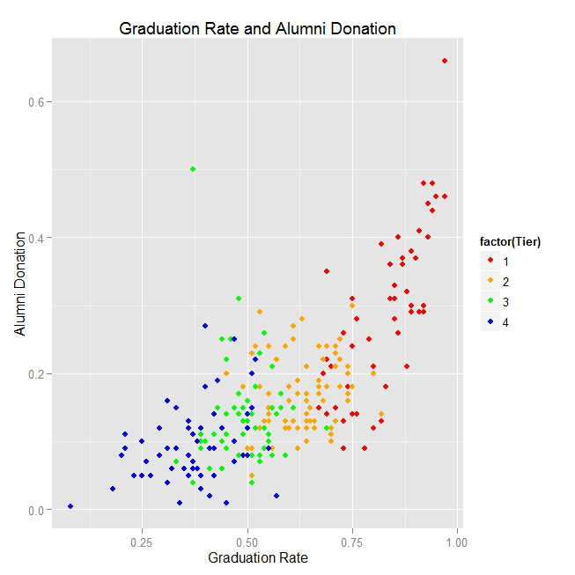
draw a scatterplot. color by factor.
Notes:
Graphic from http://blogs.bgsu.edu/statgraphicssishi/2013/04/19/r-package-ggplot2/
Ratings for National Universities based on a 2001 survey. Data available in learnEDA R package
Last accessed: 2014-01-12

Slide 5
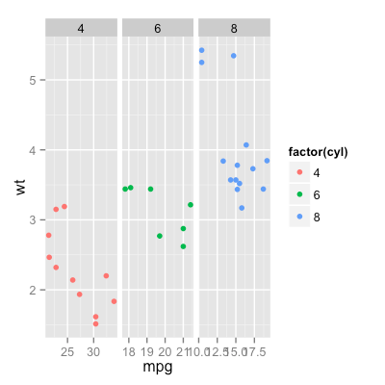
facet to explore categories.
Notes:
Created graphic using built in R dataset “mtcars”

Slide 6
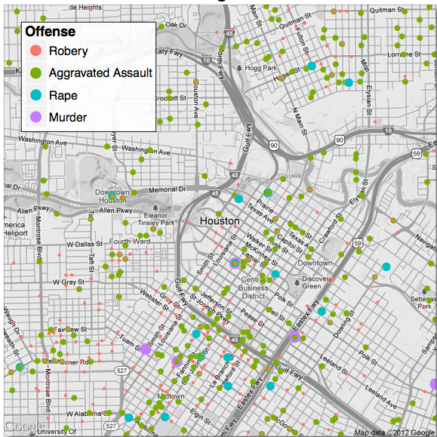
add data to a map. edit point size.
Crime in
Houston TX
Notes:
Great reference on ggmap (including this plot): http://stat405.had.co.nz/ggmap.pdf
Last accessed: 2014-01-12

Slide 7
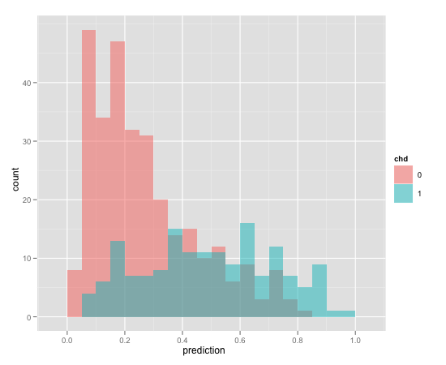
make a histogram. overlay.
Notes:
Plot from http://www.win-vector.com/blog/2011/12/my-favorite-graphs/
Last accessed: 2014-05-05

Slide 8
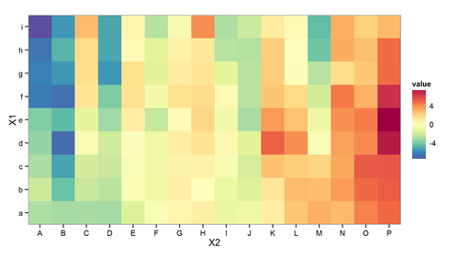
make a heat map. choose colors.
Notes:
Graphic from http://www.xeqtit.com/blog/2012/09/creating-a-heatmap-using-r-project-and-ggplot2#.U2eTOa1dV3o
Last accessed: 2014-05-05

Slide 9
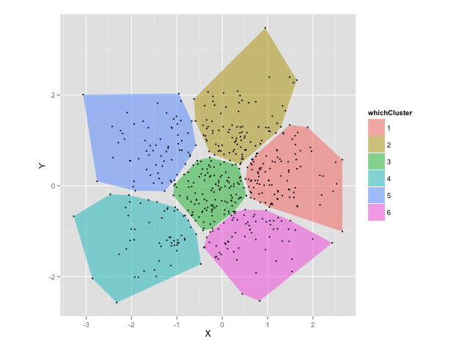
show the 2-d convex hull
Notes:
Created graphic using code from http://is-r.tumblr.com/post/33356702763/from-holey-polygons-to-convex-hulls
Last accessed: 2014-05-05

Slide 10
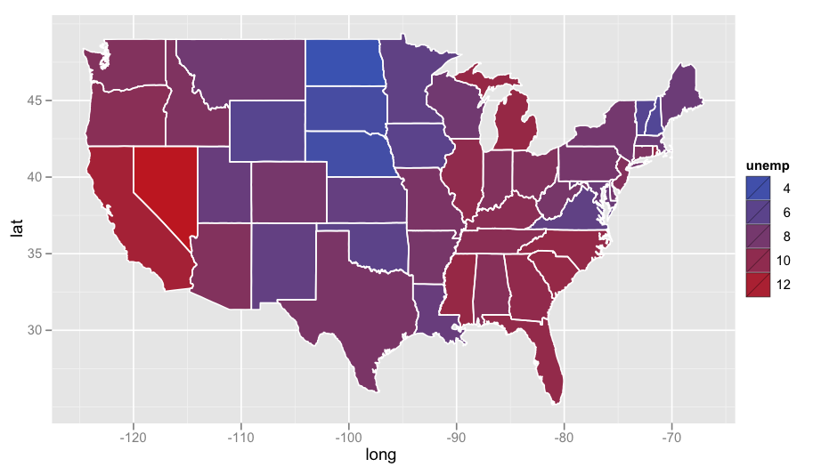
color a map according to data
US unemployment rate, 2011
Notes:
Unemployment data, Oct 2011
Graphic from http://www.r-bloggers.com/visualizing-unemployment-data/
Last accessed: 2014-05-05

Slide 11
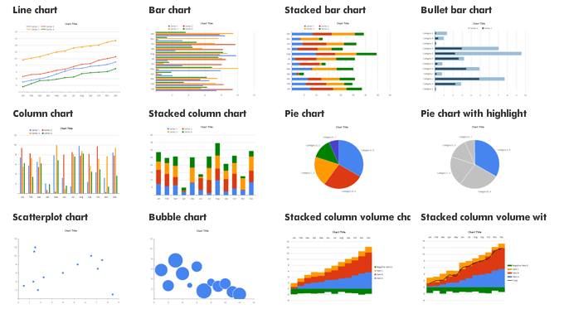
choose the right visualization
Notes:
Graphic from http://strata.oreilly.com/2010/12/quick-starts-for-charts.html
Last accessed: 2014-05-05

Slide 12
datasets we’ll explore today
anscombe’s quartet
iris dataset
election polling data
hubway data

Slide 13
hubwaydatachallenge.org
do Hubway cyclists only ride downhill?
are all Hubway rentals after 2 am only by people under 25?
how do weekday and weekend patterns differ?
finish class with our own version of hubway visualization challenge!

Slide 14
section 1 – understand data
scatterplots
clusters
map data
histograms
heat maps
Others you could investigate: box plots, cluster dendrograms, time series data, networks,…

Slide 15
what is ggplot?
“ggplot2 is a plotting system for R, based on the grammar of graphics, which tries to take the good parts of base and lattice graphics and none of the bad parts. It takes care of many of the fiddly details that make plotting a hassle (like drawing legends) as well as providing a powerful model of graphics that makes it easy to produce complex multi-layered graphics.”
-Hadley Wickham, creator, www.ggplot2.org

Slide 16
what is a data visualization?
A mapping of data properties to visual properties
Data properties are usually numerical or categorical
Visual properties can be (x,y) coordinates, colors, sizes, shapes, heights, etc

Slide 17
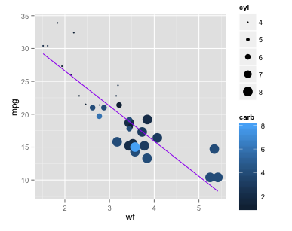
example: motor trends
mtcars:
mpg ➔ y-axis
wt ➔ x-axis
carb ➔ color
cyl ➔ size
Regression equation
➔ purple line
Notes:
Created graphic using built in R dataset “mtcars”

Slide 18
graphics in base R vs ggplot
In base R, each mapping of data properties to visual properties is its own special case
Graphics composed of simple elements like points, lines
Difficult to add elements to existing plots
In ggplot, the mapping of data properties to visual properties is done by adding layers to the plot, starting with the raw data

Slide 19
grammar of graphics
ggplot graphics consist of at least 3 elements:
Data, in a data frame
Aesthetic mapping (aes) describing how variables in the data frame are mapped to graphical attributes
color, shape, scale, x-y axes, subset groupings…
Geometric objects (geoms) determine how values are rendered graphically
points, lines, boxplots, bars, polygons, …

Slide 20
example: motor trends
mtcars:
mpg ➔ y-axis
wt ➔ x-axis
carb ➔ color
cyl ➔ size
Regression equation
➔ purple line
Notes:
Created graphic using built in R dataset “mtcars”

Slide 21
other potential layers
Statistical Transformations (stat)
(smoothing, binning in a histogram, regression lines,...)
Facets to create lattices of plots
(ex: plot each patient individually)
A coordinate system (cartesian coordinates, log coordinates, polar coordinates, map projections, …)
Scales (adjust size scales, color scales, etc)
Notes:
Guides???

Slide 22
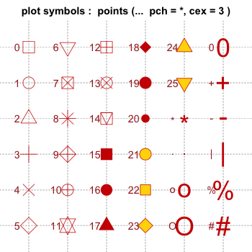
point shapes in R
Notes:
Graphic from http://www.cookbook-r.com/Graphs/Shapes_and_line_types/
Last accessed: 2014-05-05

Slide 23
exercise 1
Plot sepal length vs. petal length in a scatterplot and title the graph.

Slide 24
exercise 2
Change the size of points, by petal width.

Slide 25
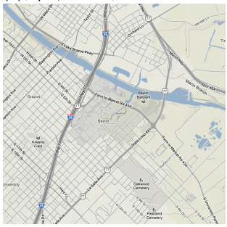
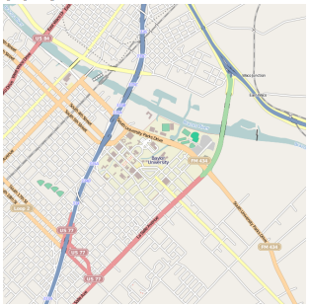
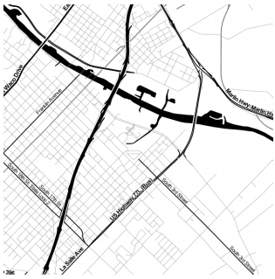
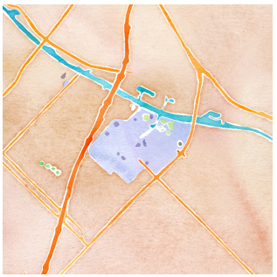
the ggmap package
source = “google”,
maptype = “terrain”
source = “stamen”,
maptype = “toner”
source = “osm”
source = “stamen”,
maptype =
“watercolor”
Notes:
Map graphics from: http://stat405.had.co.nz/ggmap.pdf
Last accessed: 2014-01-12

Slide 26
exercise 3
Plot the Hubway stations on a map of Boston.
Change the station size to be relative to the total number of trips out of the station.
Hint: First create a frequency table of trips by start station using “table” and turn this into a data frame. Then merge frequency and station data frames.

Slide 27
exercise 4
Plot a histogram of trip length.
Make bin sizes 10 minutes long.
Facet it by subscription type.
What do you notice?

Slide 28
section 2 – understand your model
add a regression line to a scatterplot
visualize output of clustering model by drawing convex hulls of clusters
plot the output of logistic regression on a map
Other model output to visualize: CART trees and partitions, Markov processes, linear regression diagnostic plots, branch & bound trees, plots of IP solver time to optimality, …

Slide 29
exercise 5
Draw a 99% confidence interval instead.
Make the regression line hot pink and large enough to show up.

Slide 30
the electoral college
The United States has 50 states
Each assigned a number of electoral votes based on population
Most votes: 55 (California)
Least votes: 3 (multiple states)
Reassigned periodically based on population change
Winner takes all: candidate with the most votes in a state gets all its electoral votes
Candidate with most electoral votes wins election

Slide 31
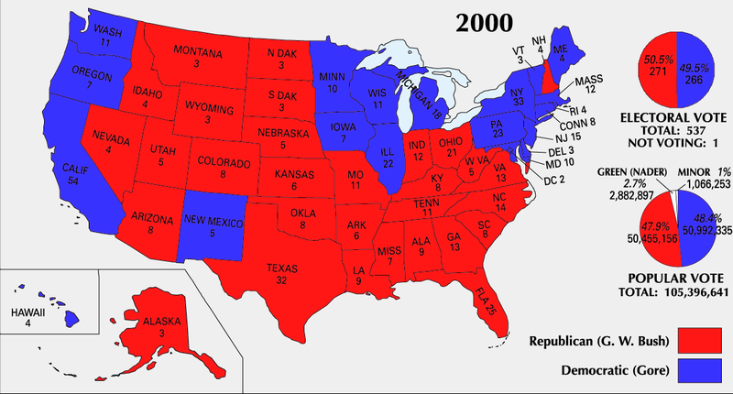
2000 Election: Bush vs. Gore
Notes:
Image source: http://commons.wikimedia.org/wiki/File:ElectoralCollege2000-Large.png
Last accessed: 2014-01-12

Slide 32

election prediction
Goal: Use polling data to predict state winners
Then-New York Times columnist Nate Silver famously took on this task for the 2012 election
Notes:
Image source: http://commons.wikimedia.org/wiki/File:Nate_Silver_2009.png
Last accessed: 2014-01-12

Slide 33
polling data
Dependent variable: Republican
1 if republican won state, 0 if democrat
SurveyUSA: polled R% - polled D%
DiffCount: polls with R winner - polls with D winner

Slide 34
exercise 6
Plot prediction results as a gradient according to logistic regression probabilities. Change the legend's title to "Prediction 2012” using the name parameter.
How do you think visualizations should best represent uncertainty? Discuss with your neighbor.

Slide 35
section 3 – communicate
colors
best practices
what not to do
next steps: making visualizations dynamic, interactive
Others you could investigate: fonts, themes, text annotations, …

Slide 36
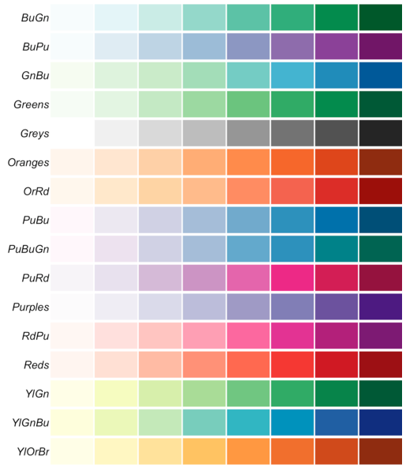
sequential palettes
For ordered data that progresses from low to high values
Notes:
Image from http://blog.ggplot2.org/post/24607351280/choosing-colour-palettes-part-ii-educated-choices
Last accessed: 2014-05-05

Slide 37
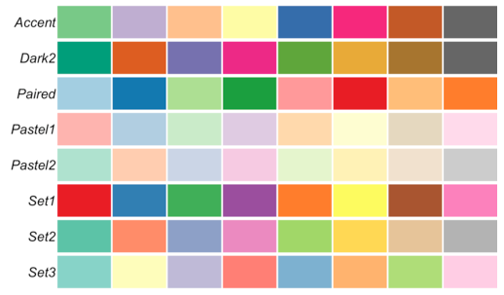
qualitative palettes
Best for categorical data
Notes:
Image from http://blog.ggplot2.org/post/24607351280/choosing-colour-palettes-part-ii-educated-choices
Last accessed: 2014-05-05

Slide 38
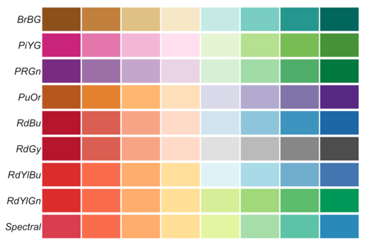
diverging palettes
Emphasize extremes
Notes:
Image from http://blog.ggplot2.org/post/24607351280/choosing-colour-palettes-part-ii-educated-choices
Last accessed: 2014-05-05

Slide 39
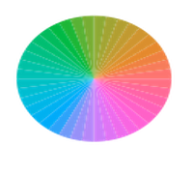
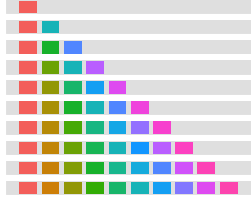
ggplot default color selection
Maximal dispersion along ggplot’s color wheel
Notes:
Left image from: http://www.ling.ohio-state.edu/~kweatherholtz/ggplot_tutorial/ggplot_ling_tutorial.html#(51)
Last accessed: 2014-05-05
Right Image from: http://www.cookbook-r.com/Graphs/Colors_(ggplot2)/
Last accessed: 2014-05-05

Slide 40
a good visualization…
accurately conveys data
distills and summarizes
helps to discern relationships
takes into account audience considerations
Notes:
Audience considerations: what do colors mean to this audience? What icons? What graphs are they used to seeing? Color blindness!

Slide 41
bad visualizations…
too much information
display choices distort reality
inconsistent scales, ordering, placement
too many colors/patterns/styles
absolute values vs. percentages

Slide 42
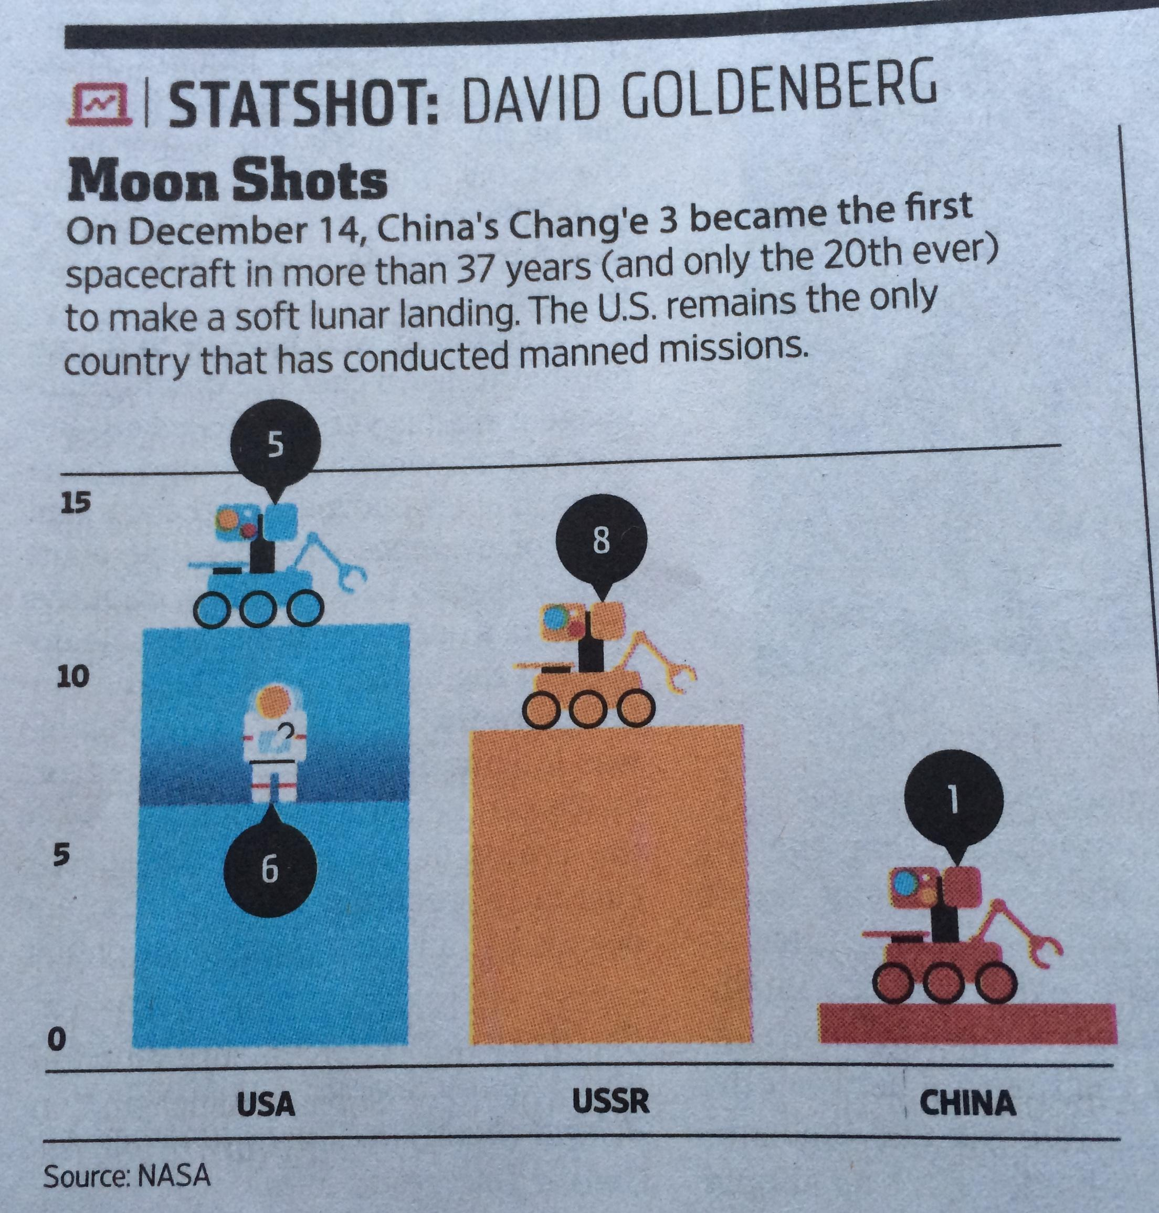
bad visualization
Height of bar is total missions to moon, which you can try to read off the y-axis or manually add numbers - redundant
Two types of missions stacked in one bar makes it hard to compare columns
Overall - too complicated

Slide 43
better version
11
Raw data is simple:
USA (5,6), USSR (8,0), CHINA (1,0)
Keep it simple - plot total missions only, unambiguous
Numbers provide details, relative scale easy to determine at a glance
8
1
USA
USSR
CHINA

Slide 44
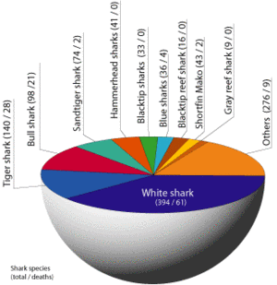
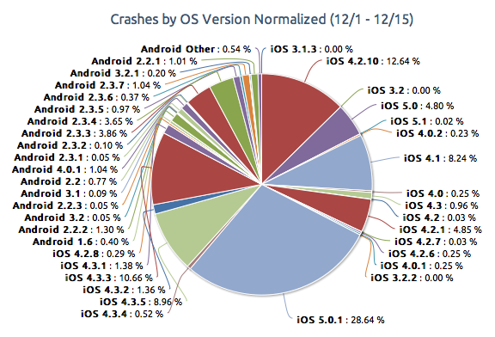
pie charts

Slide 45
pie chart issues
Inconsistent labeling
Not all points can be labeled – data lost
Colors meaningless
Arc length meaningful, but hard to compare and eye is drawn to area
3D even worse: adds no information

Slide 46
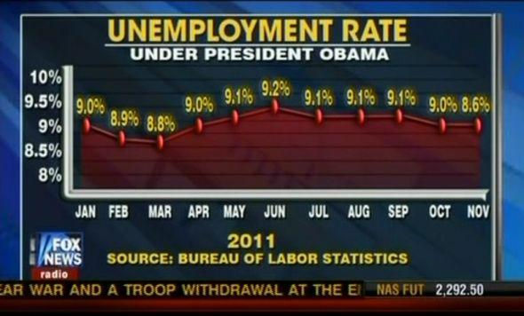
misleading scales
Notes:
-The numbers are inconsistent (ie 8.6% is plotted at 9%)
-The y-axis doesn’t start from 0

Slide 47
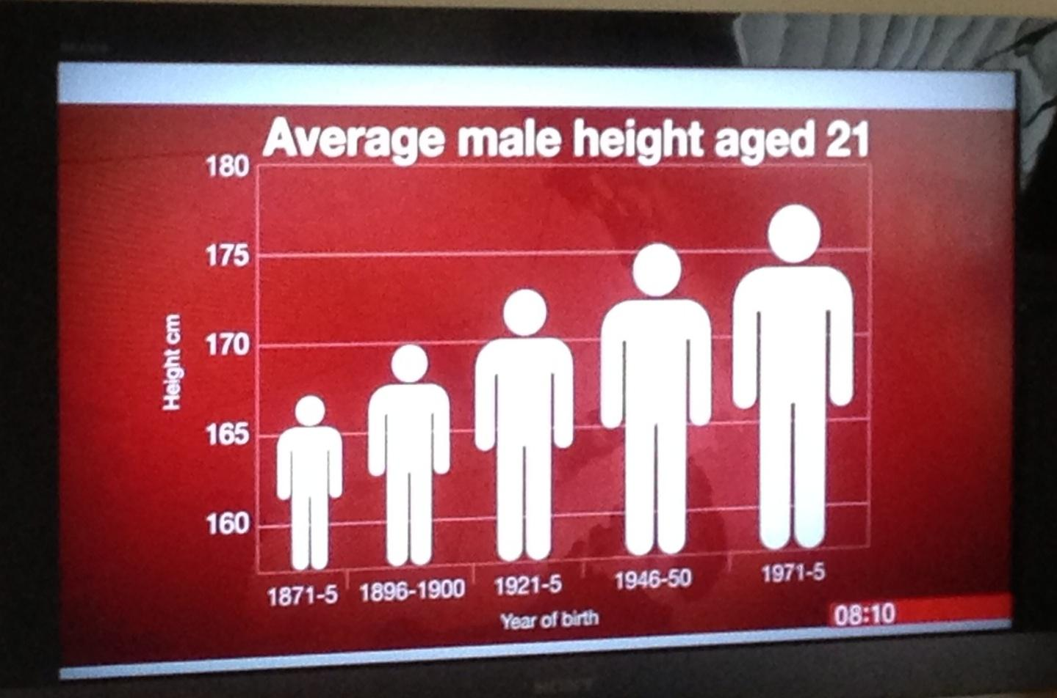
midgets to giants? not really…
Notes:
-Again, choice of y-axis skews perspective
-x-axis intervals are not the same width

Slide 48
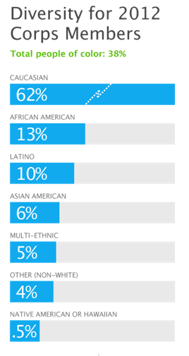
just plain ridiculous
Notes:
-The colors representing the percentages are not true to the magnitude of the percentages
-See 0.5% compared to 4%
-See 62%

Slide 49
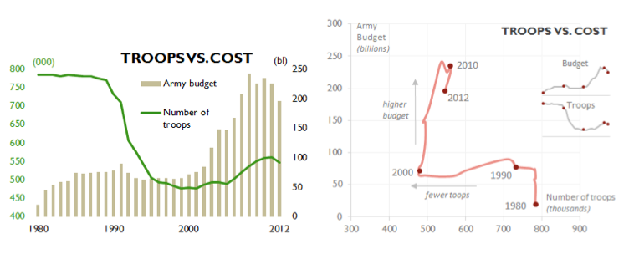
dual axis confusion
Notes:
-Plotting 2 vertical axes on this plot makes it look like there is a crossover in the mid 1990s

Slide 50
better version
Notes:
-shows that there is no crossover

Slide 51
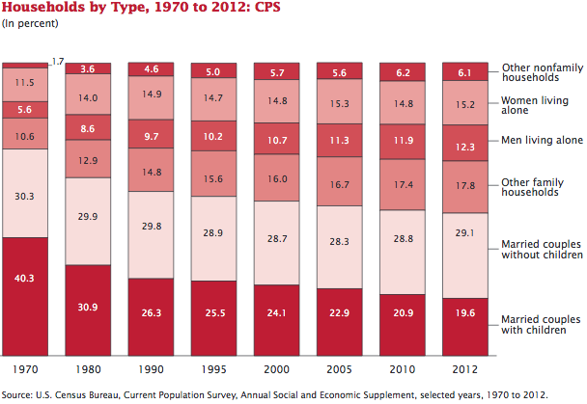
difficult to read
Notes:
-hard to compare rectangles that are offset, ie the “married couples without children” statistics
-x-axis has inconsistent intervals

Slide 52
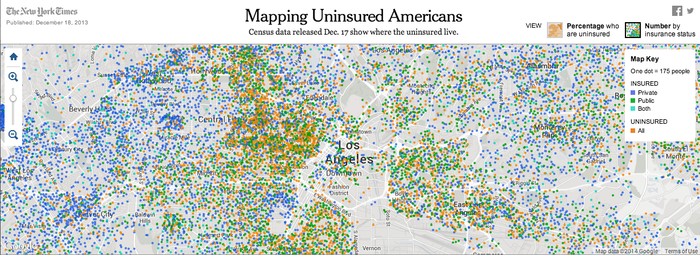
good visualization
Notes:
Image from www.nytimes.com
Last accessed: 2014-01-12

Slide 53
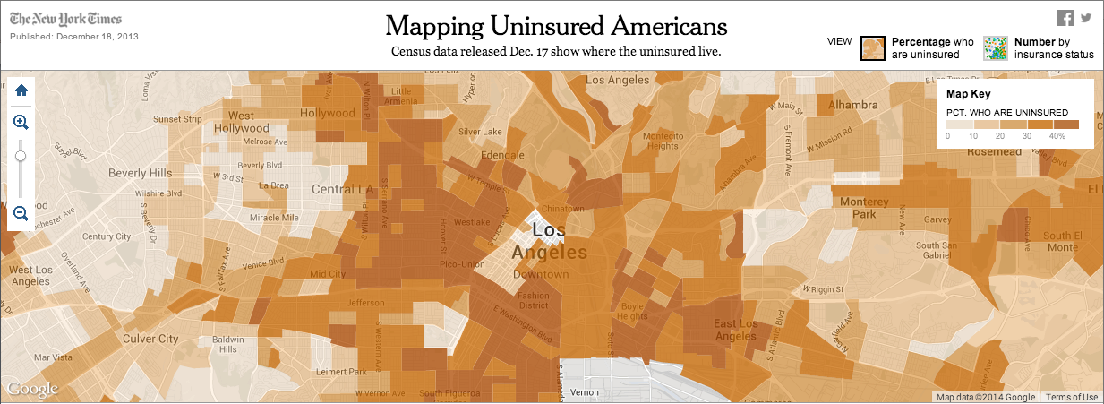
better visualization
Notes:
Image from www.nytimes.com
Last accessed: 2014-01-12

Slide 54
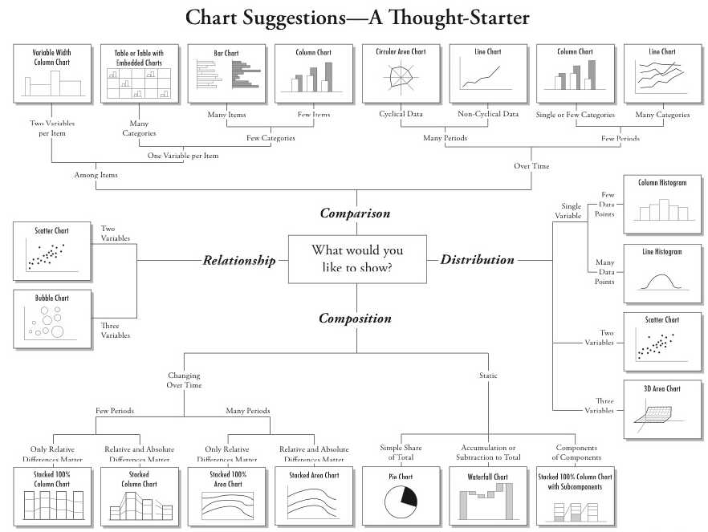
Notes:
Suggestion for what type of chart to use
Image source: http://extremepresentation.typepad.com/files/choosing-a-good-chart-09.pdf
Last accessed: 2014-05-05

Slide 55
next steps…dynamic, interactive

Slide 56
references for visualization in R
R Graphics Cookbook by Winston Chang
Same content available online
http://www.cookbook-r.com/
docs.ggplot2.org
ggmap
http://stat405.had.co.nz/ggmap.pdf
shiny
http://www.rstudio.com/shiny

Slide 57
other visualization tools
d3.js
Tableau
network visualization
In R: igraph, ggnet
Other software: nodeXL, gephi, …
map visualization
QGIS, ArcGIS, …
Notes:
arcGIS windows only
QGIS open source, very tightly integrated with R, interface to open street maps

Slide 58
we have covered
ggplot’s grammar of graphics
Understand your data
scatterplot (size, shape, color, use a map as background)
heat map
histogram – concept of faceting
Understand your model
add a regression line to a scatterplot
classification output – color a map
draw the convex hull of a set of points
Communicate
colors
best practices
what not to do
More advanced
references
other tools
what’s next: dynamic, interactive visualizations
YOUR TURN

